Slide 1

Group 9 Rohan Patel Kyle Romm Daniel Nazarian Jamie Maignan

Slide 2
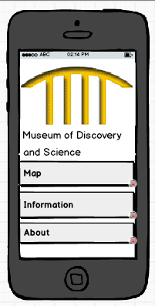
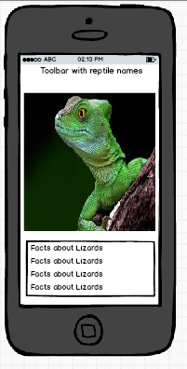
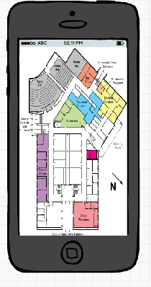
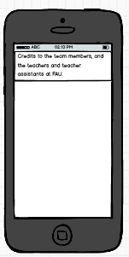
Story Board
Main Menu
Information
Map
About

Slide 3
Goal
Our group’s goal is to create an informative and entertaining Android app for anybody visiting the Museum of Discovery and Science that enhances both the experience and knowledge of the visitor.
Our app will include an information page about the reptile exhibit, a general map of the facility, and an app info page.

Slide 4
Information
Our app will provide expansive information about the reptiles exhibit.
The information will cover each of the different reptiles within the exhibit in-depth.
Each reptile will have its own page with facts and pictures about the animal.
The information section of our app strives to be educational for both children and adults.
The information will be include the reptile’s size, habitat, and diet
If the parents wish, they may choose to use this page to teach their children about the animals as they make their way through the exhibit.
We hope that the information will help parents better educate their children about the animals, and provide awareness and create interests in these reptiles.

Slide 5
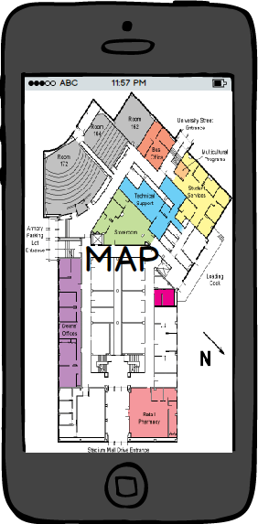
Map
Our app will include a map that can direct the visitor to rest rooms, specific exhibit areas, and areas to buy gifts, drinks, food, etc.
The map feature will provide the visitor with easy access to wherever they wish to go within the museum. The map will help the user navigate through the museum and the different floors and exhibits in a streamlined manner.
The map will also include arrows that point to where the reptile exhibit is located in the museum on the map

Slide 6
App Info
Lastly, our app will include a page with some background information on the creation of the app and credits.
Our app will tell the user who contributed what part of the app.

Slide 7
Conclusion
To conclude, our app strives to provide and educational, informative, and entertaining experience for the visitors of the Museum of Discovery and Science.
We feel that our app covers many different aspects that will enhance the visitor’s experience at the Museum of Discovery and Science.
The information sections of the app are implemented to help the parents visiting the museum teach their children about the exciting reptiles at the Museum of Discovery and Science.

